Slide 1
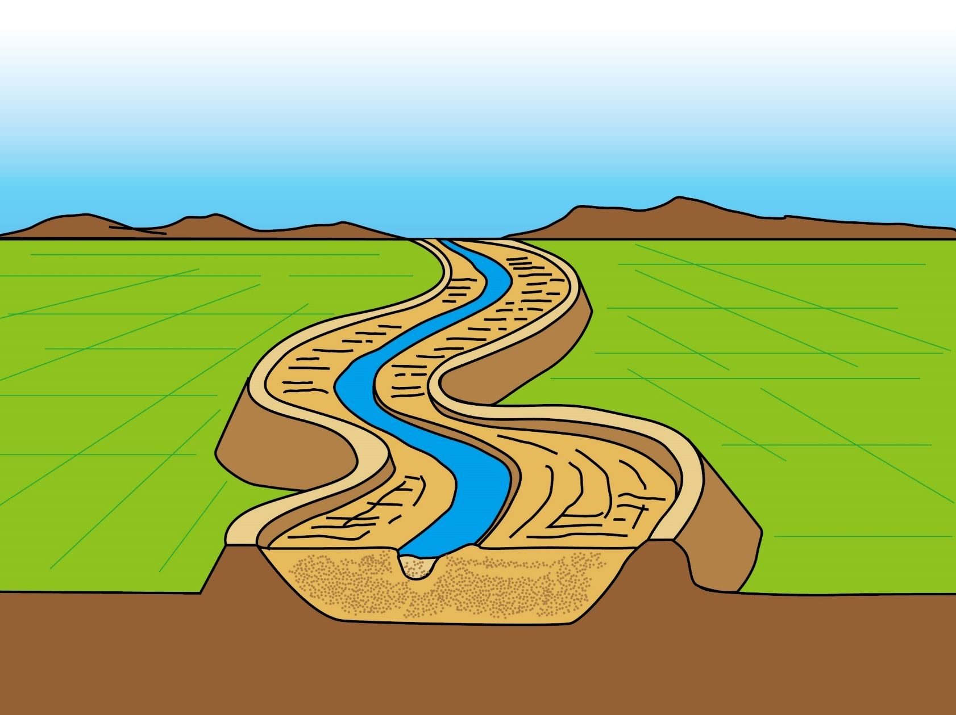
PowerPoint Series on Geography of China (5) – Case study on fluvial landform features of our country: Chang Jiang
Personal, Social and Humanities Education Section
Curriculum Development Institute, Education Bureau
Student Self-study Version

Slide 2
The “most” of chang Jiang
Among the longest rivers in the world, Chang Jiang (6,300 km) is ranked as the third longest, after the Amazon River in South America and the Nile River in Africa. Huang He is the fifth longest in the world (Figure 1).
Chang Jiang originates from Tanggula Mountains on the Qinghai-Tibetan Plateau and it flows through 11 regions (including provinces, municipalities and autonomous regions) - Qinghai, Xizang, Sichuan, Yunnan, Chongqing, Hubei, Hunan, Jiangxi, Anhui, Jiangsu and Shanghai. Besides, the tributaries of Chang Jiang flow through parts of provinces like Gansu, Guizhou, Shaanxi, Guangxi, Henan, Zhejiang and Guangdong. In the end, Chang Jiang flows into the East China Sea in Shanghai (Figure 2).
Chang Jiang is the longest river in our country, with the highest annual runoff and largest drainage area.

Slide 3
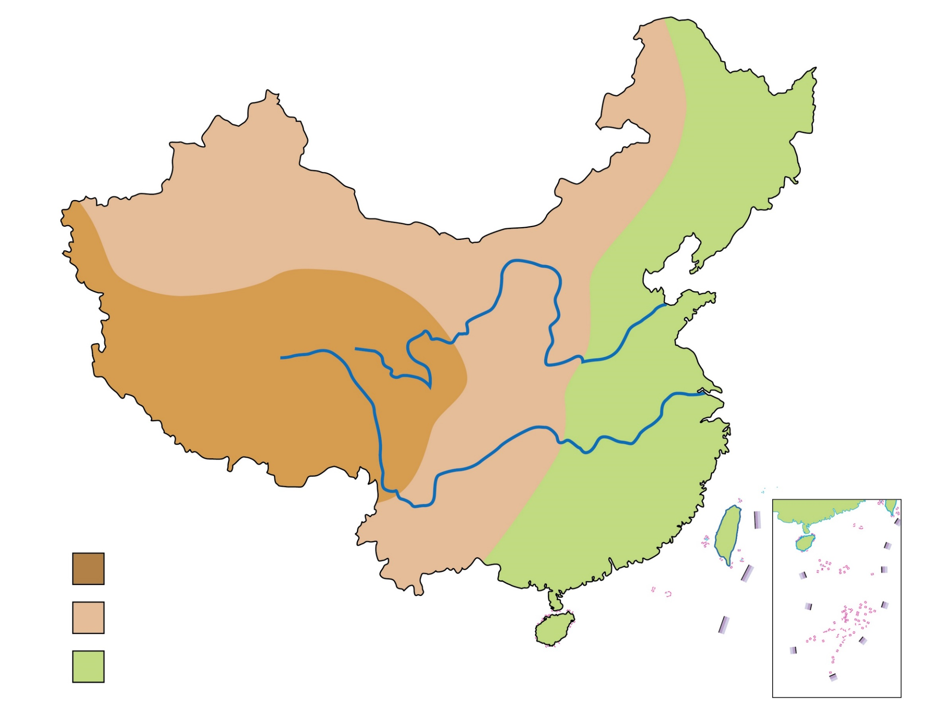
Figure 1 A map showing the three-step (three-tier) staircase pattern of relief & major rivers of our country (& related information)
River | Length of the river (Source of data：《China Statistical Yearbook 2021》) | Annual runoff (Source of data：《China Statistical Yearbook 2021》)
Huang He | 5,464 km | 59.2 billion cubic meters
Chang Jiang | 6,300 km | 985.7 billion cubic meters
Huang He
Chang Jiang
Key
1st tier/step
2nd tier/step
3rd tier/step

Slide 4
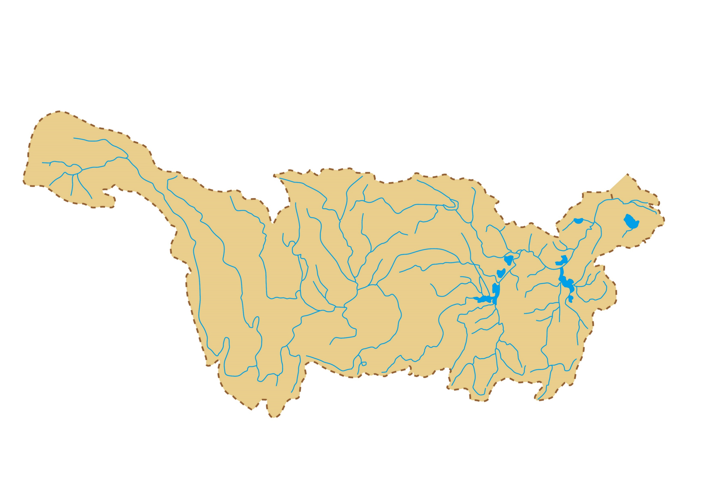
Figure 2 Distribution map of the drainage area of Chang Jiang
Nanjing
Tuotuohe
Shanghai
Tongtianhe
Wuhan
Tanggula Mountain Ranges
Daduhe
Hanshui
East China Sea
Yalong River
Jinshajiang
Wujiang
Chengdu
Changsha

Slide 5
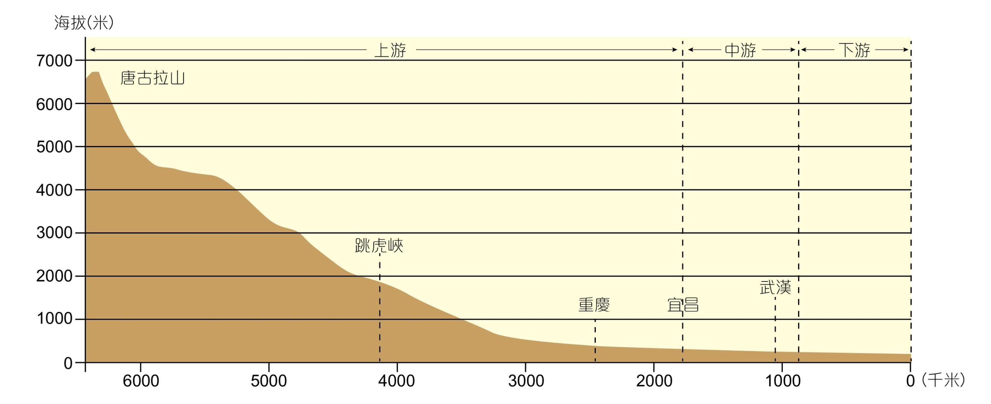
The upper, middle & lower courses of chang jiang
Altitude (m)
Middle course
Lower course
Upper course
Tanggula Mountains
Tiger Leaping Gorge
Chongqing
Yichang
Wuhan
West
East
(km)
Figure 3 A profile of Chang Jiang

Slide 6
Originating from Tanggula Mountains, the characteristics of the upper, middle and lower courses of Chang Jiang are as follows (Figure 3):
Upper course: The upper course of Chang Jiang runs from its origin to Yichang in Hubei, passing through the 1st and 2nd steps/tiers of our country’s topography and receiving a substantial amount of water from many of its tributaries. With a sharp drop in elevation, rapid flows and a lot of gorges, hydroelectric power resources in the upper course of Chang Jiang are rich.
Middle course: The middle course of Chang Jiang runs from Yichang to Hukou in Jiangxi and receives water from different drainage systems in the plain region. Flooding occurs easily as there is large inflow of water. This is especially the case at the Jing River section with meandering river channels.

Slide 7
The middle course of Chang Jiang is characterised by flat terrain, slow water flow, meandering of river channels, concentration of tributaries, large increases in water volume and numerous lakes (interconnection of rivers and lakes). The most famous lakes in this part of Chang Jiang are Dongting Lake and Poyang Lake.
3) Lower course: The lower course of Chang Jiang runs from Hukou of Jiangxi and flows through regions of plains to its river mouth. Due to the large volume of water flow and low-lying terrain, this part of Chang Jiang is prone to flooding.
The lower course of Chang Jiang is characterised by broad river channels, short tributaries, interconnection of rivers and seas and having numerous sand bars. Among them, Shanghai's Chongming Island is a sand bar formed by the deposition of sediments of Chang Jiang.

Slide 8
The study of the landform features of the lower course & estuary of chang jiang
Chang Jiang, originates from the Tanggula Mountains, is the longest river in our country. It gathers more than 700 large and small rivers along the way and flows into the East China Sea at Shanghai.
Therefore, the area around Shanghai and Suzhou is a region for studying the landform features of the lower course and estuary of Chang Jiang (Figure 4).

Slide 9
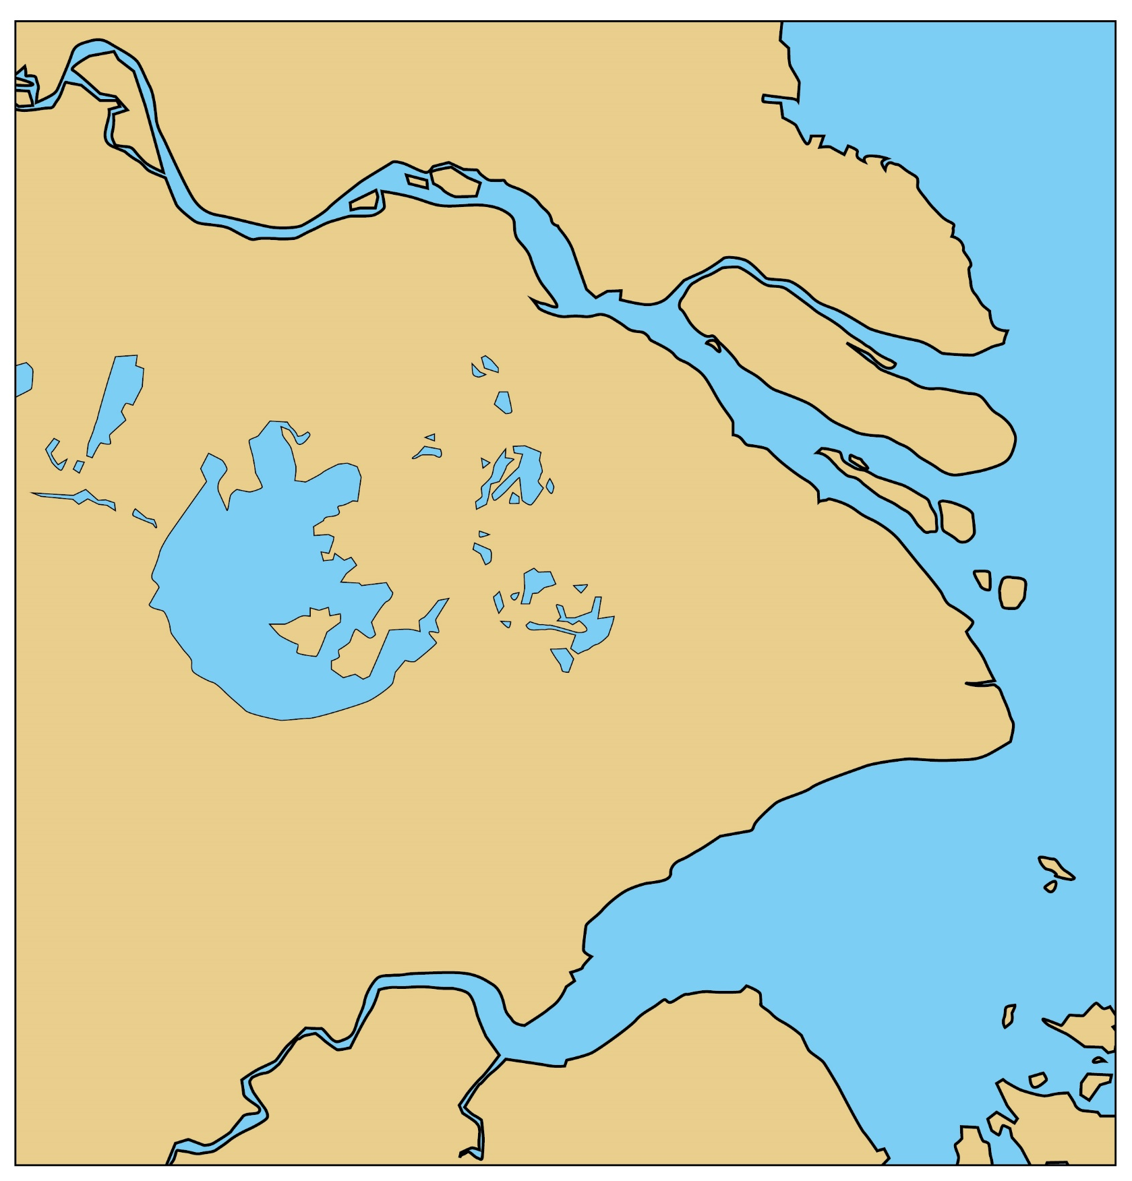
Lower course & estuary of Chang Jiang
Chongming Island, Shanghai
A part of the Chang Jiang Delta
Hengsha Island
Yangcheng Lake
Jiuduansha
Dianshan Lake
Taihu Lake, Suzhou
Changxing Island
Figure 4 The distribution of major fluvial landform features of the lower course & estuary of Chang Jiang

Slide 10
1) The formation of taihu lake:
There are many lakes in the middle and lower courses of Chang Jiang. Although the reasons for their formation are different, they are all river lakes related to the development and evolution of Chang Jiang.
Taihu Lake at Suzhou is located on the Chang Jiang Delta Plain. There are many lakes in the Chang Jiang Delta - Taihu Lake Group in the south (including Taihu Lake, Dianshan Lake, Yangcheng Lake, etc.) and Hongze Lake Group in the north.

Slide 11
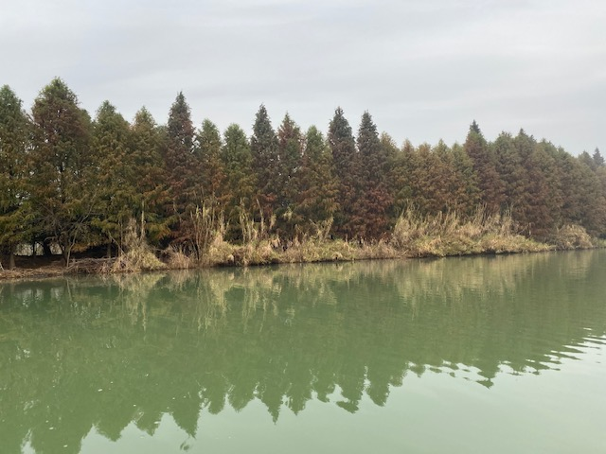
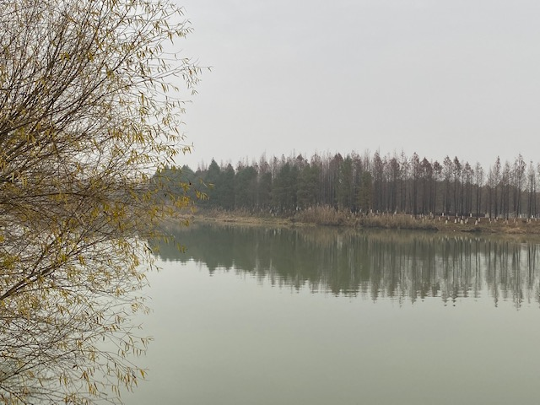
Figure 5 Taihu Lake Wetland

Slide 12
The formation of Taihu Lake is closely related to the development process of Chang Jiang. It was originally a coastal lagoon formed at the river mouth of Chang Jiang (Figure 6). The formation process of the Lake is as follows:
1) Chang Jiang and some other rivers flowed into the East
China Sea with a large amount of sediments.
2) After entering the sea, the flow velocity of the rivers was
slowed down because of the diffusion of water flow at
the river mouths/estauries. Due to other factors, like tides, a
large amount of sediments were then deposited at the river
mouth of Chang Jiang.
3) Two groups of spits in the shape of a Chinese character
“八” were formed in the estuaries of Chang Jiang and
the nearby Qiantang River respectively.
4) After a certain period of time, the spits of the two
rivers were connected to separate the original waterfront
from the sea.

Slide 13
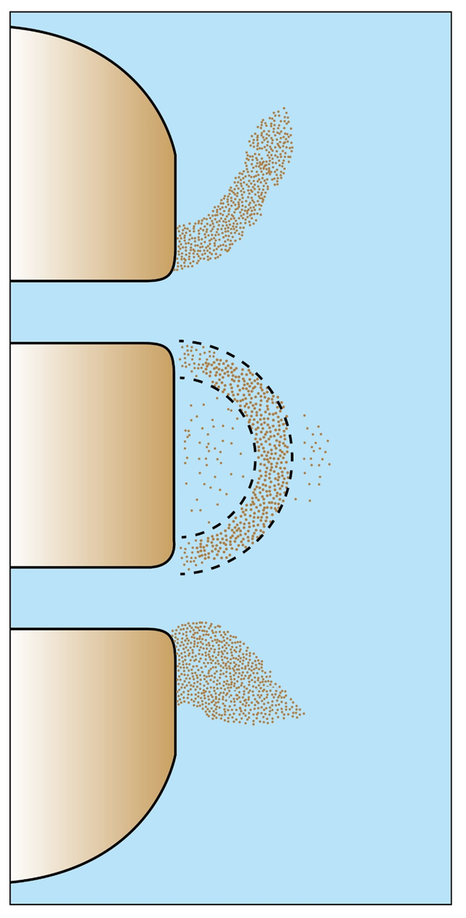
Figure 6 A sketch showing the formation of Taihu Lake
A spit
Chang Jiang
Taihu Lake
Qiantang River
A spit

Slide 14
5) The lagoon being formed is Taihu Lake.
6) As the delta extended outwards, the distance
between Taihu Lake and the sea increased.
7) The original water in the lagoon was salty
seawater, but after being separated from the
sea, the rivers (and their water) around the
lagoon continuously flowed into the lake and
changed its water into freshwater.
8) The area of the ancient Taihu Lake was very
large, but due to the continuous siltation
brought along with the river, the lake surface
has continued to shrink. The ancient Taihu Lake
is now being divided into several groups of lakes,
such as Taihu Lake, Dianshan Lake and
Yangcheng Lake.

Slide 15
9) Nowadays, Taihu Lake discharges water into Chang Jiang through the Huangpu River. The entire Taihu Lake system can greatly reduce the threat of floods to Shanghai.
2. The formation of the Chang Jiang Delta:
Although the sediment content of Chang Jiang is less than that of Huang He, the average annual sediment input into the sea is nearly 500 million tonnes. The sediments accumulate at the river mouth of Chang Jiang and fill the sea to form the land of the Chang Jiang Delta with an area of about 30,000 km². The elevation of the delta is generally 4-8 meters and there are lots of rivers, lakes and fertile land.

Slide 16
The current Chang Jiang Delta has been formed on the basis of the ancient delta for about 6,000 years:
About 6,000 years ago, Chang Jiang entered the sea in Zhenjiang and Yangzhou. Due to the influence of tides, most of the sediments brought by Chang Jiang were deposited to form sand spits in the shape of a Chinese character “八”. The spit in the south roughly extended southeastward from Jiangyin towards Hangzhou Bay and then connected with the spit of Qiantang River to form the ancient Taihu Lake.
Since the original sand spits are higher than Taihu Lake, the delta area at the south bank of the Chang Jiang Estaury still maintains a dish-shaped depression centered on Taihu Lake and the Taihu Plain is also regarded as the main body of the Chang Jiang Delta.

Slide 17
3) In the same way, another sand spit at the
north bank of the Chang Jiang Estuary also extended
eastwards near Yangzhou, reaching the vicinity of
Nantong. The north of the sand spit is the
Lixia River Plain formed by the alluvial sediments
transported from the ancient Huai River and
Huang He. A dish-shaped depression was formed at
the Lixia River.
4) Thus, the two dish-shaped depressions at the south
and north banks of the Chang Jiang Estuary
constituted the main body of the Chang Jiang Delta.
5) At the same time, the sediments of Chang Jiang
continued to accumulate along the coast and formed a
new delta.

Slide 18
6) As the vegetation in the drainage basin of Chang Jiang has been destroyed by human beings, the amount of sediments transported by Chang Jiang has increased greatly. In addition, human beings have built sea embankments at the river mouth of Chang Jiang, which has caused sediments to accumulate outside the sea embankments and has accelerated the expansion of the Chang Jiang Delta. Over the past 2,000 years, the north and south sand banks of the Chang Jiang Delta had been expanded outward by about 7,500 km².
Since Shanghai is part of the alluvial plain of the Chang Jiang Delta, the general terrain of Shanghai is low and flat, with an average height of only 4m above sea level.

Slide 19
Because Shanghai is part of the alluvial plain of the Chang Jiang Delta, the rivers in the area are intertwined and there are many lakes. Most of the rivers and lakes in Shanghai are connected to Taihu Lake in the upstream, and most of them flow into the Huangpu River (the largest river in Shanghai) downstream. Finally, they flow into the East China Sea through the Chang Jiang Estuary.

Slide 20
3. The formation of chongming island
The river channels at the Chang Jiang Estaury are wide. Coupled with the influence of ocean tides, the water flow velocity there is slow. This is beneficial to sediment deposition and leading to the formation of various large and small sand bars in the center of the Chang Jiang Estuary. Chongming Island, Changxing Island and Hengsha Island are examples of this. Chongming Island, with an area of more than 700 km², is the largest alluvial island in the world and the third largest island in our country.

Slide 21
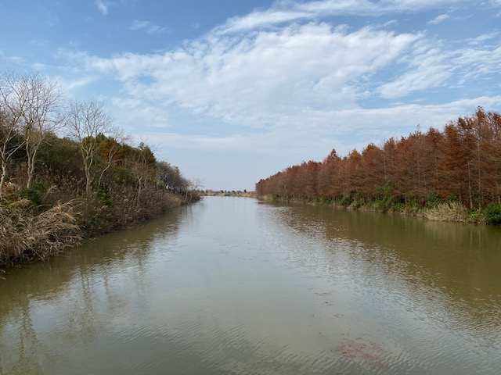
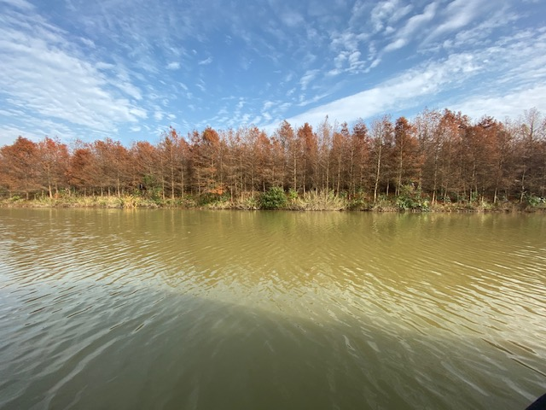
Figure 7 Chongming Dongtan Wetland

Slide 22
Up to now, the land at the eastern tip of Chongming Island and the eastern part of Shanghai is still growing due to the deposition and siltation of sediment at the Chang Jiang Estuary. In addition, south of the three islands of Chongming Island, Changxing Island and Hengsha Island, another new sand island has been formed and emerged from the water – it is called Jiuduansha and is the youngest sand island in Shanghai today (Figure 7-10).

Slide 23
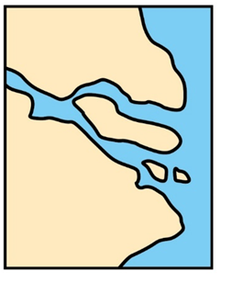
1. About 6,000 years ago
2. About the third century AD
Figure 7 A series of sketches showing the development of Chang Jiang Delta
3. Nowadays

Slide 24
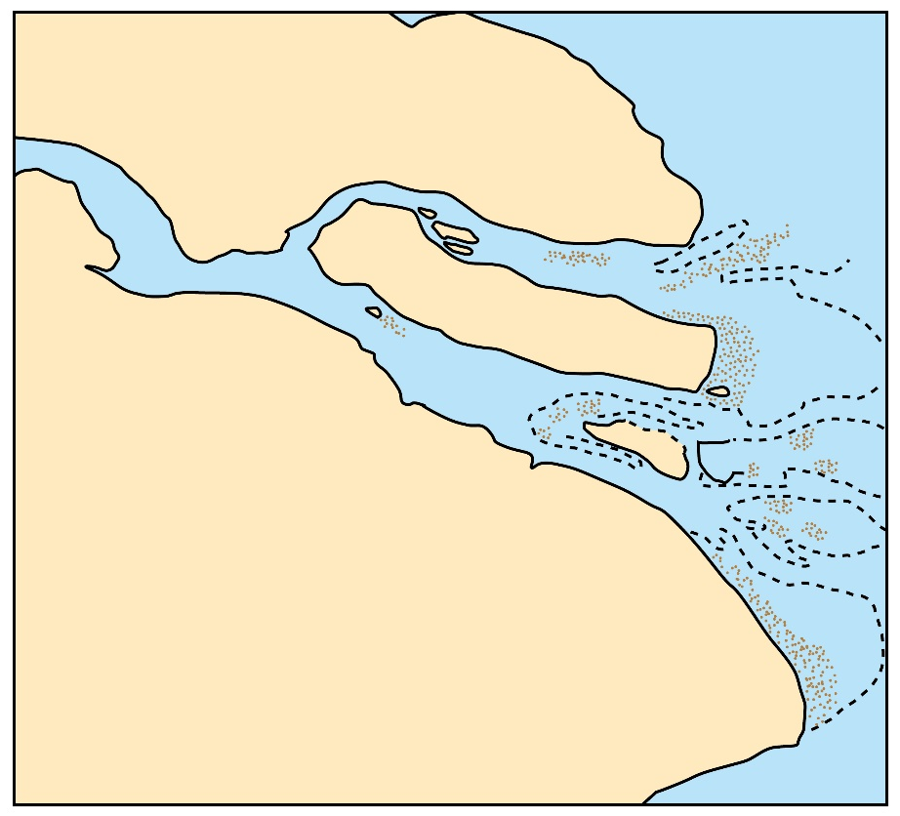
Chang Jiang
Chongming Island
Figure 8 The present locations of Chongming Island and Changxing Island
Changxing Island

Slide 25
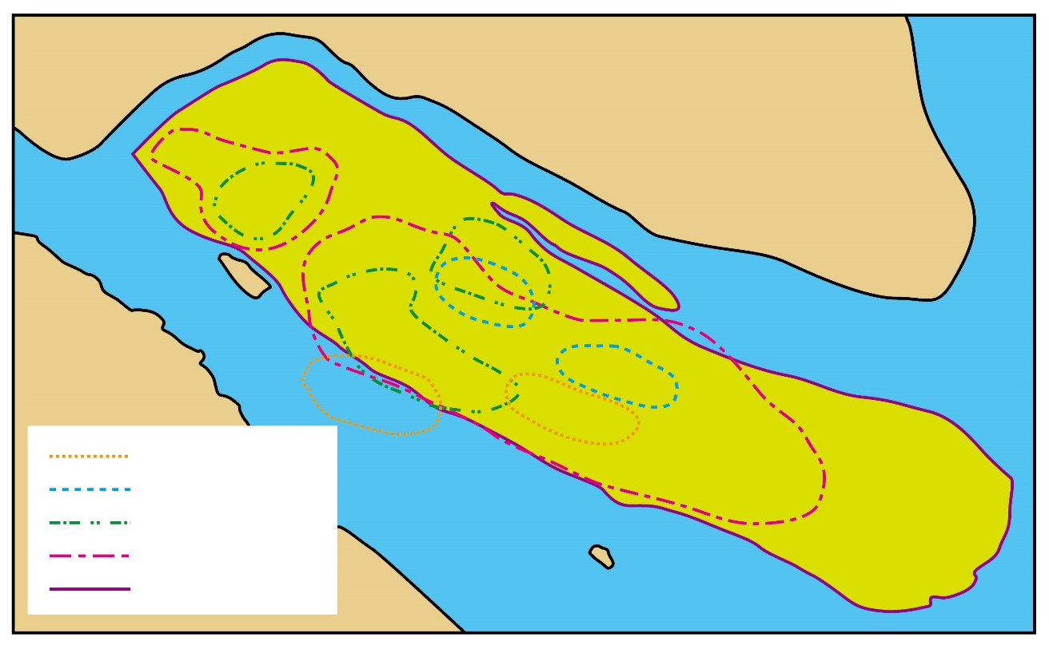
Key
Sand bars that appeared in different periods:
Between Tang and Song Dynasty
Song Dynasty
Mid Ming Dynasty
Late Ming to early Qing Dynasty
Chongming Island at present
Chongming Island
Figure 9 The development of sand bars at Chang Jiang Estaury in different periods and the formation of Chongming Island

Slide 26
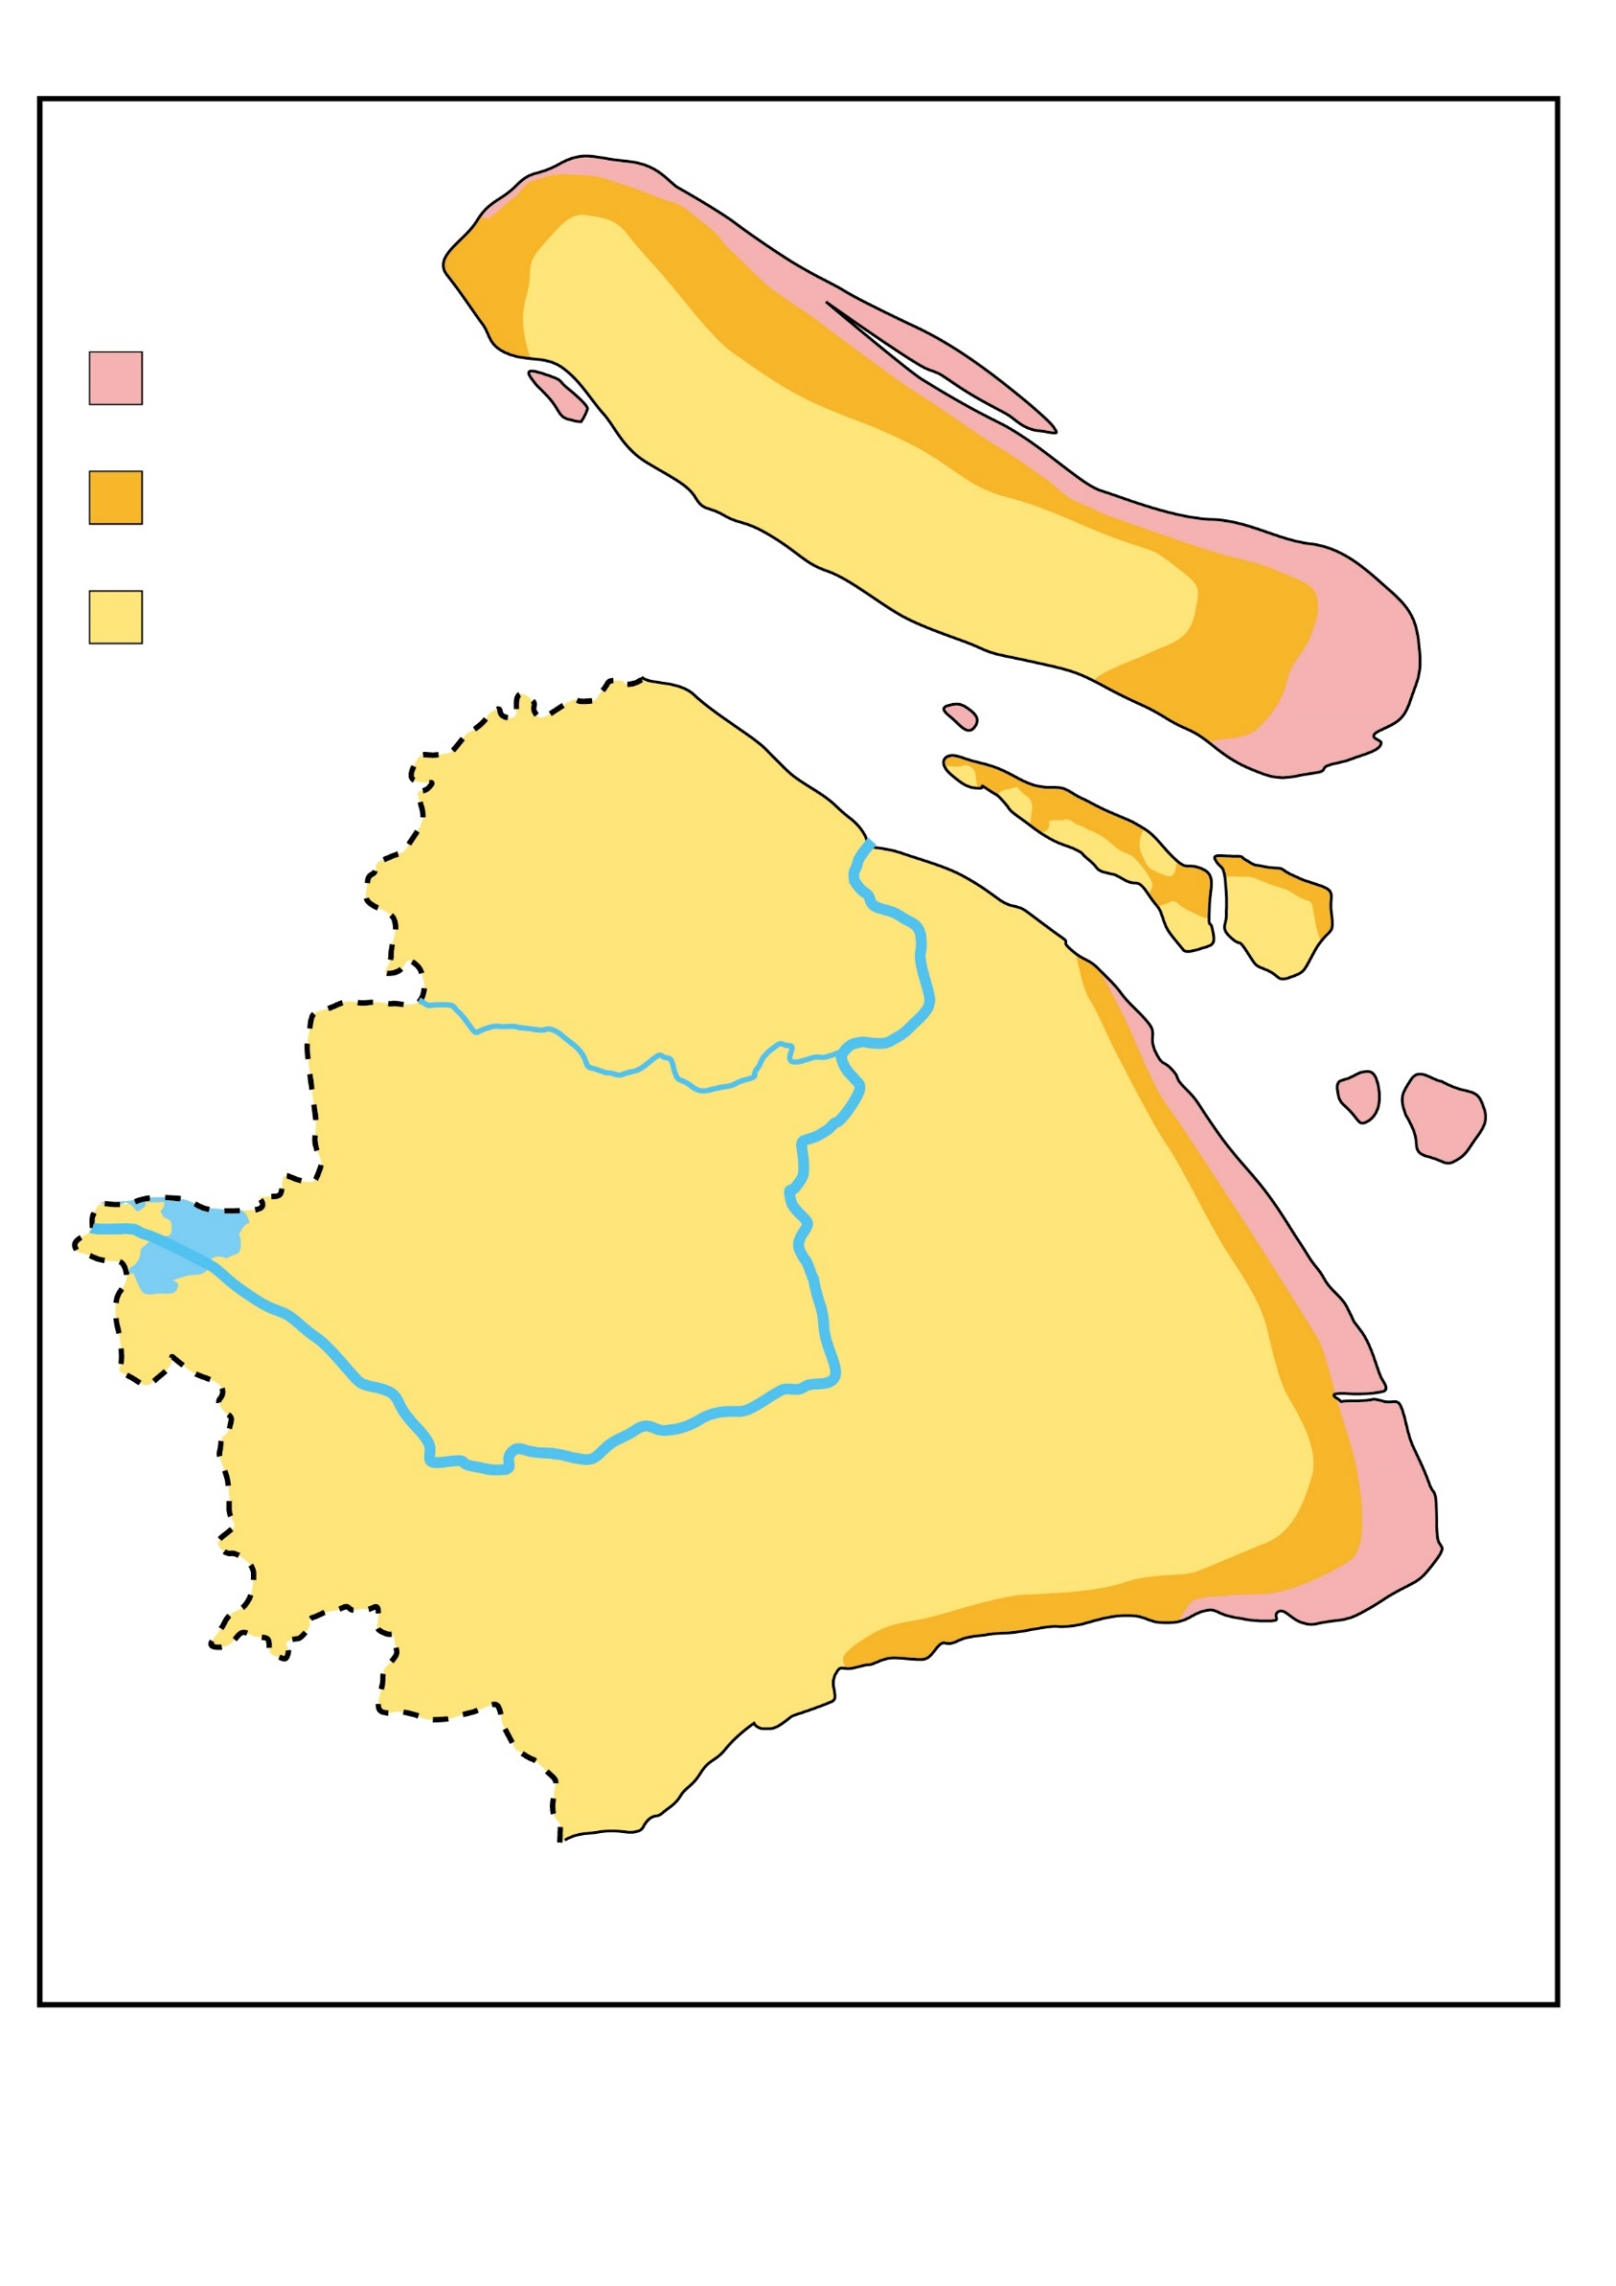
Siltation and land reclamation after 1980
Siltation and land reclamation after 1950
Chongming Island
Dongtan
Land area in 1950
Suzhou River / Wusong River
Huangpu River
Figure 10 A map showing tidal flat siltation in Shanghai

Slide 27
references：
方如康（1995）《中國的地形》。北京：商務印書館。
章銘陶編著 (2004) 《中國大地 – 水域世界》。香港：商務印書館(香港)有限公司。
裘腋成等 (2007)《上海市鄉土地理 (試用本)》。上海：上海教育出版社。
黃錫荃等（1995）《中國的河流》。北京：商務印書館。

